Slide 1

R.M.K. ENGINEERING COLLEGE (An Autonomous Institution)
(Affiliated to Anna University, Chennai / Approved by AICTE, New Delhi / Accredited by NAAC with A+ Grade /
ISO 9001:2015 Certified Institution / All the Eligible UG Programs are Accredited by NBA, New Delhi.)
RSM Nagar, Kavaraipettai – 601 206, Gummidipoondi Taluk, Thiruvallur District.
Department of Civil Engineering

Slide 2
CE8711 - Creative and Innovative Project First Review

Slide 3
DESIGN AND ANALYSIS OF RESIDENTIAL BULIDING
Project Supervisor
Dr . Murali Krishna T
Professor
Batch Members
1. P. Sireesha 111719103020
2. Pravalika 111719103023
3. B.Mahalakshmi 111719103014
4. T.Swathi 111719103034

Slide 4
Problem Description
Our project deals with the plan and design of a Bank building. It is a reinforced concrete framed structure consisting of G + 1 with adequate facilities.
IS 456:2000 codes is the basic code for general construction in concrete structures, hence all the structural members are designed using limit state method in accordance with the IS 456:2000 code and design aids.
The planning of any building in India will be recognized by National Building Code (NBC) , hence the building is planned in accordance with the National Building Code of India.

Slide 5
Problem Description
The building includes the following :
In first floor:-
Shops and Parking
In second floor:-
1. Hall
2. Bedroom
3. Kitchen
4. lobby
5. pooja room
6. Toilet

Slide 6
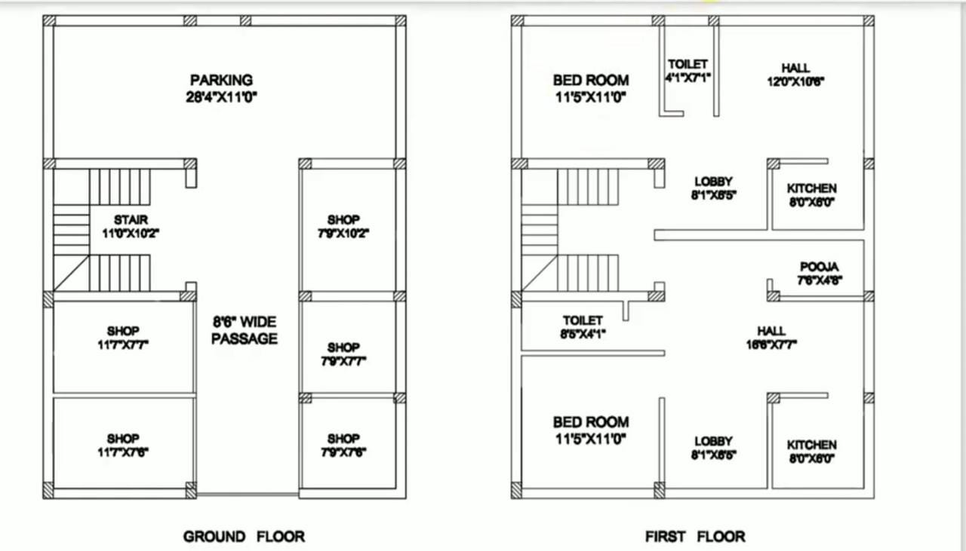
Plan

Slide 7
Specification Requirements as per NBC 2017 for the Proposed Plan Given
Main door : 3’6”x6’0”
Bedroom door : 3’0”x6’0”
Guest door : 3’0”x6’0”
Drawing room : 3’0”x6’0”

Slide 8
\Methodology
Collection of Data
Planning
AutoCAD
Load Calculation
MS Excel
Analysis
Staad Pro
Bending Moment & Shear Force
Designing
Slab,Beam,Column,
Footing,Staircase
Conclusion

Slide 9
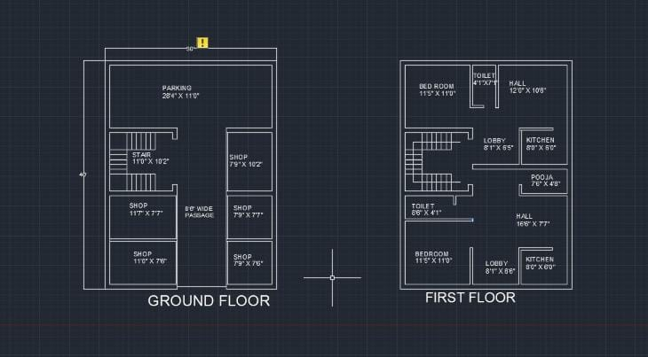
Work Done So Far

Slide 10
Load calculations
Roof slab :
Assume the thickness of slab = 6” = 15 cm
Self weight of 6” thick slab = 25 X 0.15
= 3.75 KN/m2
Live load = 1.5 KN/m2
Floor finishing = 1.5 KN/m2
Additional = 1.0 KN/m2
Total = 7.75 KN/m2
Factored load = 11.625 KN/m2

Slide 11
Load calculations
Floor slab :
Assume the thickness of slab = 6” = 15 cm
Self weight of 6” thick slab = 25 X 0.15
= 3.75 KN/m2
Live load = 3.0 KN/m2 [Refer IS 875]
Assume Floor finishing = 1.5 KN/m2
Partition walls = 1.0 KN/m2
Total = 9.25 KN/m2
Factored load =13.875KN/m2

Slide 12
Load on the frame D-1-2-3
Load on roof beam D-1-2
Assume roof beam size = 230 mm X 450 mm
Ly/Lx = 3.6/3.45 = 1.04 < 2 (2 way slab)
Equivalent udl = (wLxr)/(2+r)
= (11.625x3.45x1.04)/(2+1.04)
= 13.72 KN/m
Self weight of roof beam = 25x0.23x0.45x1.5
= 3.88KN/m
Load due to parapet wall = 20x0.23x0.45x1.5
= 6.9 KN/m
Total load on roof beam D-1-2 = 24.5KN/m

Slide 13
Load on roof beam D-2-3
Ly/Lx = 5.3/3.6 = 1.47 < 2 (2 way slab)
Equivalent udl = (wLxr)/(2+r)
= (11.625x3.6x1.47)/(2+1.47)
= 17.72KN/m
Self weight of roof beam = 25x0.23x0.45x1.5
= 3.88KN/m
Load due to parapet wall = 20x0.23x1x1.5
= 6.9 KN/m
Total load on roof beam D-2-3 = 28.5KN/m

Slide 14
Load on floor beam D-1-2
Equivalent udl = (wLxr)/(2+r)
= (13.875x3.45x1.04)/(2+1.04)
= 16.37 KN/m
weight of wall = 20x0.23x3x1.5 = 20.7KN/m
Total load = 40.95KN/m
Load on floor beam D-2-3
Equivalent udl = (wLxr)/(2+r)
= (14.875x3.6x1.47)/(2+1.47) = 22.68 KN/m
Self weight of floor beam = 25x0.23x0.45x1.5 = 3.88KN/m
Wall load = 20x0.23x3x1.5 = 20.7 KN/m
Total load = 47.26 KN/m

Slide 15
Load on plinth beam
Load on plinth beam = 25x0.23x0.45x1.5 = 3.88KN/m
Weight of the wall = 20x0.23x3x1.5 = 20.7KN/m
Total load acting on plinth beam = 25KN/m

Slide 16
Load on roof beam C-1-2
Assume roof beam size = 230 mm X 450 mm
Ly/Lx = 3.45/3.35 = 1.03 < 2 (2 way slab)
Equivalent udl = (wLxr)/(2+r)
= (11.625x3.35x1.03)/(2+1.03)
= 13.23 KN/m
Self weight of roof beam = 25x0.23x0.45x1.5
= 3.88KN/m
Trapezoidal load from previous slab = 13.72KN/m
Total load on roof beam C-1-2 = 30.83KN/m

Slide 17
Load on roof beam C-2-3
Ly/Lx = 5.3/3.35 = 1.58 < 2 (2 way slab)
Equivalent udl = (wLxr)/(2+r)
= (11.625x3.35x1.58)/(2+1.58)
= 17.33KN/m
Self weight of roof beam = 25x0.23x0.45x1.5
= 3.88KN/m
Load from previous slab = 17.72 KN/m
Total load on roof beam C-2-3 = 38.93 KN/m

Slide 18
Load on floor beam C-1-2
Self weight of floor beam = 25x0.23x0.45x1.5
= 3.88 KN/m
Equivalent udl = (wLxr)/(2+r)
= (13.875x3.35x1.03)/(2+1.03)
= 15.8 KN/m
weight of wall = 20x0.23x3x1.5 = 20.7KN/m
Load from previous slab = 16.37 KN/m
Total load = 56.75 KN/m

Slide 19
Load on floor beam C-2-3
Self weight of floor beam = 25x0.23x0.45x1.5
= 3.88 KN/m
Equivalent udl = (wLxr)/(2+r)
= (13.875x3.35x1.58)/(2+1.58) = 20.5 KN/m
Load from previous slab = 21.16 KN/m
Wall load = 20x0.23x3x1.5 = 20.7 KN/m
Total load = 66.24 KN/m
Load on plinth beam
Load on plinth beam = 25x0.23x0.45x1.5 = 3.88KN/m
Weight of the wall = 20x0.23x3x1.5 = 20.7KN/m
Total load acting on plinth beam = 25KN/m

Slide 20
Load on roof beam B-1-2-3
Assume roof beam size = 230 mm X 450 mm
Ly/Lx = 3.45/3.35 = 1.03 < 2 (2 way slab)
Equivalent udl = (wLxr)/(2+r)
= (11.625x3.35x1.03)/(2+1.03)
= 13.23 KN/m
Self weight of roof beam = 25x0.23x0.45x1.5
= 3.88KN/m
Trapezoidal load from previous slab = 13.72KN/m
Total load on roof beam C-1-2 = 30.83KN/m

Slide 21
Design of slab
Size of the slab : 4.5m x 2.7m
Width of the support = 230mm
Assume M20 grade concrete and Fe415 steel (Limit State method)
Assume overall depth of the slab = 150mm
Effective depth provided = 150 – 20 – (10/2)
= 125mm
Type of the slab
Ly/lx = (4.5/2.7) = 1.66 < 2 (Therefore, two way slab)

Slide 22
Calculation of the effective span
As per clause 22.2 of IS456 – 2000, the effective span will be the least of the
following two values :
1.Clear span + effective depth = 2.7+0.125 = 2.825m
2.Centre to centre of supports = 2.7+0.23 = 2.93m
Adopt lesser value of effective span = 2.825m

Slide 23
Load calculation
Self weight of the slab = 25x0.15
= 3.75KN/m2
Live load on the slab =1.5 KN/m2
Floor Finishing = 1.5 KN/m2
Additional load = 1KN/m2
Total load = 7.75KN/m2
Factored load = 11.625KN/m2

Slide 24
Design moments and shear force
As per Table 27 of IS456-2000, for 1/1.66, the value of moment coefficients are
a, -0.109. a -0.04.
Moment along the shorter span, M. -awl, 0.109x11.625x2 825x2.82510.11KNm.
Moment along the longer span, M, as wl. 0.04x11.625x2.825x2.825 3.71KNm

Slide 25
Check for effective depthAs per IS456-2000,Mulim 0.138fbd10.11x10^6 0.138x20x1000xd-d=62.52mmd=125mm. Hence the section is adequate.
zmalong the shorter spanMus/bd (10.11x10^6)/(1000x125x125

Slide 26
References
Books
1. Structural Analysis by Shri.S.RAMAMRUTHAM
2. Design of RCC structures by Shri.B.C PUNIMA
Code Books
1. IS800CODE
2. IS 875 PART – I, II, III.

